Slide 1

Hospital Emergency Room Dashboard – Power BI Project

Slide 2
Problem Statement:
To enhance operational efficiency and provide actionable insights into emergency room performance, we need to create a Hospital Emergency Room Analysis Dashboard in Power BI. This solution will enable stakeholders to track, analyze, and make data-driven decisions regarding patient management and service optimization.

Slide 3
Key KPIs
Number of Patients:
Measure the total number of patients visiting the ER daily.
Average Wait Time:
Calculate the average time patients wait before being attended to by a medical professional.
Patient Satisfaction Score:
Analyze the average satisfaction score of patients on a daily basis to evaluate the quality of service provided.
Number of Patients Referred:
Count the number of patients referred to specific departments from the ER each day.

Slide 4
Dashboards Included
Monthly View – Month-over-month trends and demographic insights
Consolidated View – Aggregated metrics across custom periods
Patient Details – Row-level view of individual patient data
Summary View – Key insights and actionable recommendations

Slide 5
Tools Used
Power BI
DAX
Power Query
Excel

Slide 6
Objective: Monitor key metrics and trends on a month-by-month basis to identify patterns and areas for improvement.
Charts to Develop:
Patient Admission Status: Track admitted vs. non-admitted patients.
Patient Age Distribution: Group patients by 10-year age intervals.
Department Referrals: Analyze referral trends across different departments.
Timeliness: Measure the percentage of patients seen within 30 minutes.
Gender Analysis: Visualize patient distribution by gender.
Racial Demographics: Analyze patient data by race.
Time Analysis: Assess patient volume by day and hour.
Monthly View

Slide 7
Objective:
Provide a holistic summary of hospital performance for a selected date range.
Charts to Develop:
Similar metrics as the Monthly View, but aggregated over a customizable date range for broader insights and trend analysis
Consolidated View

Slide 8
Objective:
Offer granular insights into patient-level data to enable detailed analysis and troubleshooting.
Charts to Develop:
A grid displaying essential fields:
Patient ID
Patient Full Name
Gender
Age
Admission Date
Patient Race
Wait Time
Department Referral
Admission Status
Patient Details

Slide 9
Summary View
Objective:
Summarize the findings from all dashboards to provide clear and actionable insights for stakeholders.
Charts to Develop:
Descriptive analysis of each metric and visualization, including patterns, anomalies, and actionable recommendations to optimize emergency room operations and patient care

Slide 10
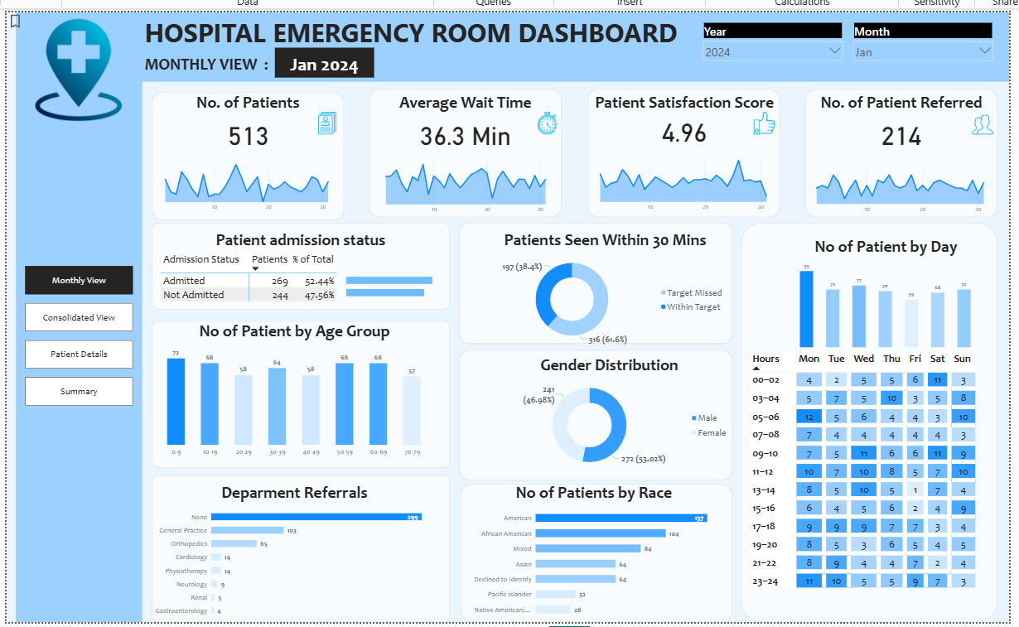

Slide 11
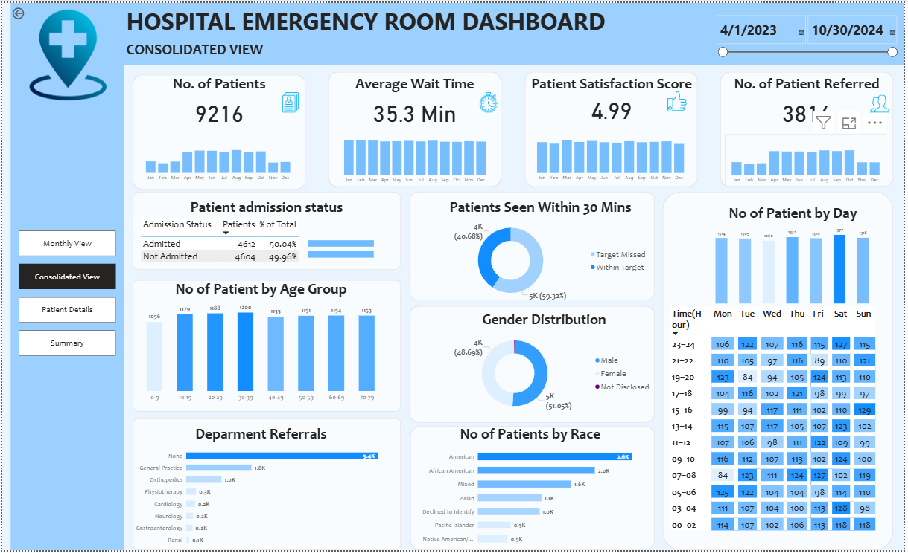

Slide 12
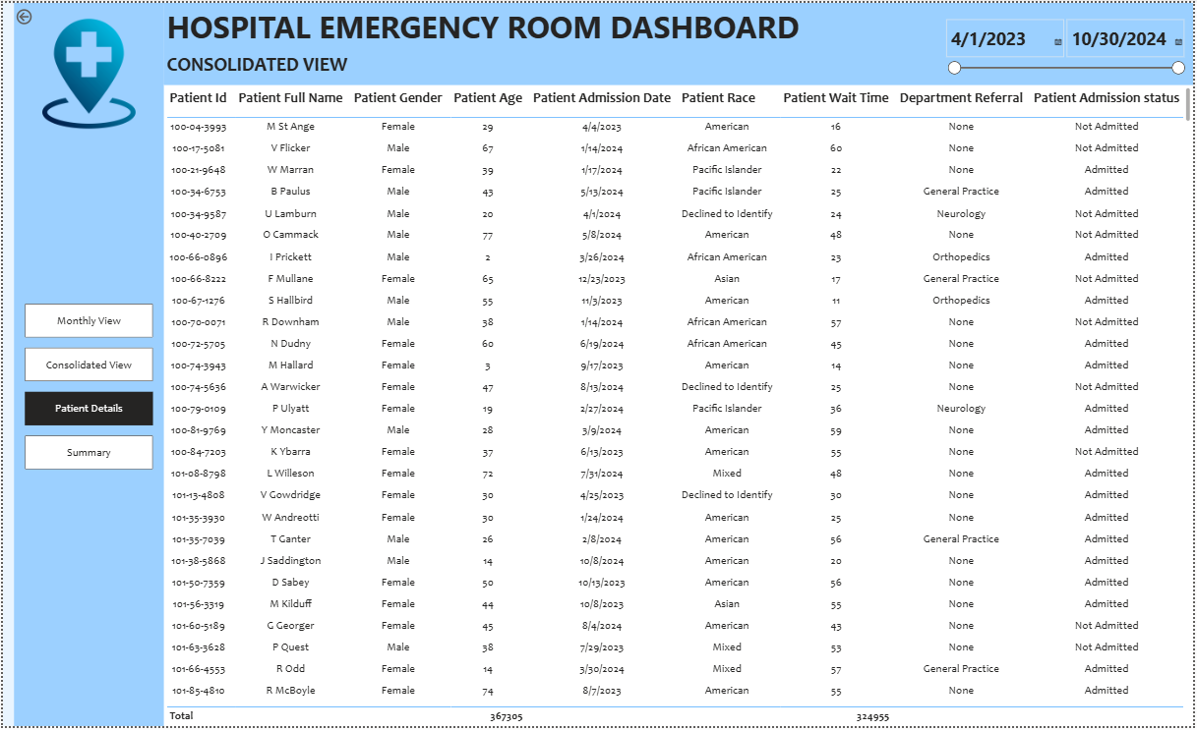

Slide 13
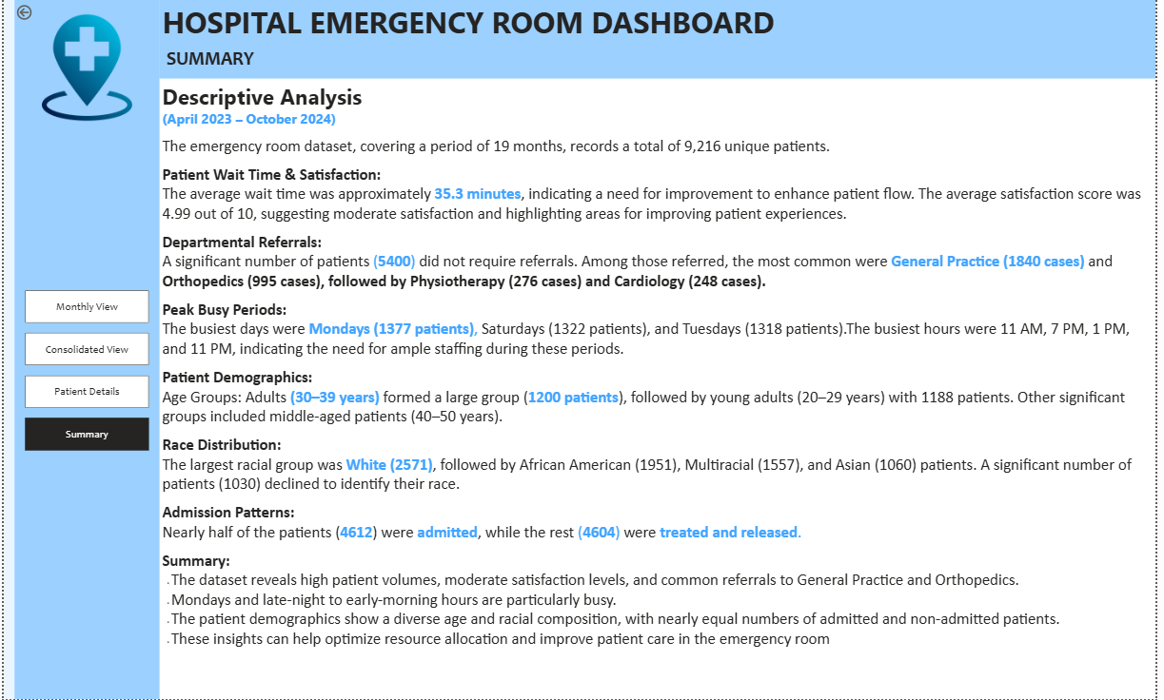

Slide 14
Insights & Value Added
Insights:
Identified peak patient hours for better staffing.
Highlighted long wait times for operational improvement.
Improved patient satisfaction tracking via KPI dashboards.
Enhanced departmental resource allocation.
Value Added:
Improved operational efficiency
Reduced patient waiting times
Enhanced service quality
Data-driven decision-making for hospital management

Slide 15
Recommendations
Schedule staff based on peak patient hours.
Allocate additional resources to high-referral departments.
Implement continuous KPI monitoring using the dashboard.
Use patient feedback trends to improve service quality.

